Slide 1
Partial loss of Tip60 slows mid-stage neurodegeneration in a spinocerebellar ataxia type 1 (SCA1) mouse model -Kristen M. Gehrking, J. Michael Andresen, Lisa Duvick, John Lough, Huda Y. Zoghbi, & Harry T. Orr
Presented by: Jessica Taghon
BIOL 506
November 21, 2011

Slide 2
Outline
Introduction
Objective
Results
Conclusion
Future Research/Critique

Slide 3
Introduction
SCA1: dominantly inherited neurodegenerative disease
Caused by polyglutamine tract expansion of ATXN1
ATXN1: normal function regulates gene expression
Mutant gene contains polyglutamine tract expansion
Tip60: acetyltransferase
binds with ATXN1 by AXH domain
Rora: controls gene expression
Complexes with ATXN1/Tip60

Slide 4
Objective
Importance: Slow progression of SCA1
Understand mechanism of neurodegeneration in SCA1
Biological importance of ATXN1/Tip60 interaction
Impact of Tip60 haploinsufficiency
On progression of neurodegeneration
On Rora protein and gene expression

Slide 5
Results
ATXN1 deletion constructs
GST-pull-down assay to assess ATXN1/Tip60 interaction
S776D substitution mimics phosphorylation and enhances disease severity
Measurement of molecular thickness in Purkinje cells
Partial Tip60 loss slowed neurodegeneration in ATXN1[82Q]:Tip60^{+/-} mix mice during mid-stage of disease
Partial Tip60 loss effect on Rora protein and gene expression

Slide 6
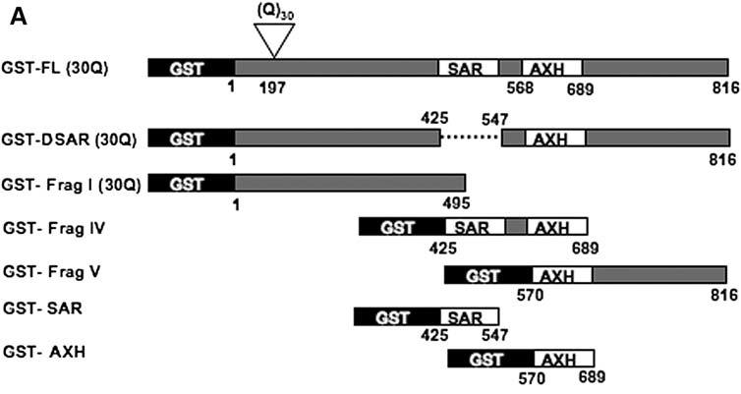
ATXN1 deletion constructs

Slide 7
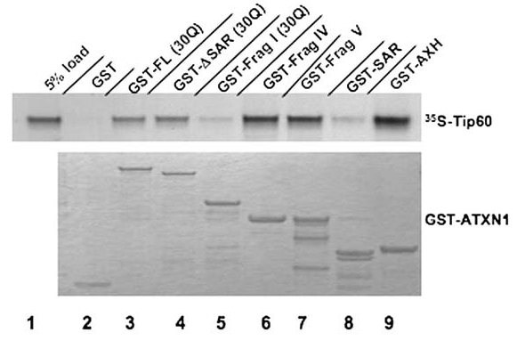
GST-pull-down assay to assess ATXN1/Tip60 interaction

Slide 8
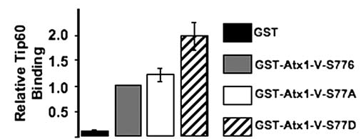
S776D substitution mimics phosphorylation and enhances disease severity

Slide 9
Mouse Models
SCA phenotype: ATXN1[82Q] mice
FVB background
Tip60^{+/-} mice
SV-129;C57BL/6 background
Viable, phenotypically normal
Tip60^{-/-} mice lethal near blastocyst stage
Cross of ATXN1[82Q] mice and Tip60^{+/-} mice (mix)
WT
ATXN1[82Q]:Tip60^{+/-}
ATXN1[82Q]:Tip60^{+/+}
Tip60^{+/+}

Slide 10
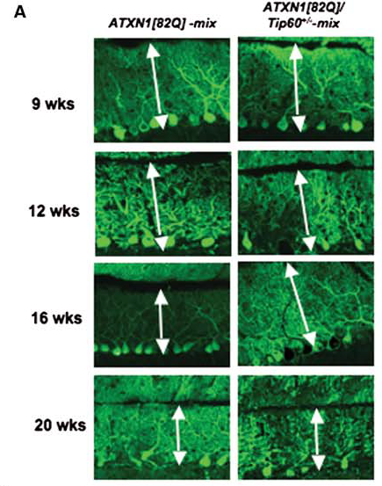
Measurement of molecular thickness in Purkinje cells

Slide 11
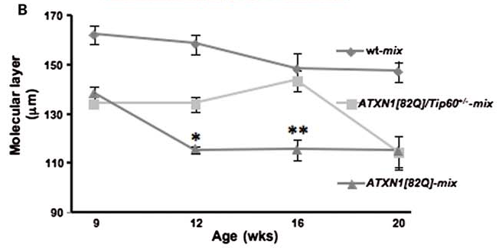
Partial Tip60 loss slowed neurodegeneration in ATXN1[82Q]:Tip60^{+/-} mix mice during mid-stage of disease

Slide 12
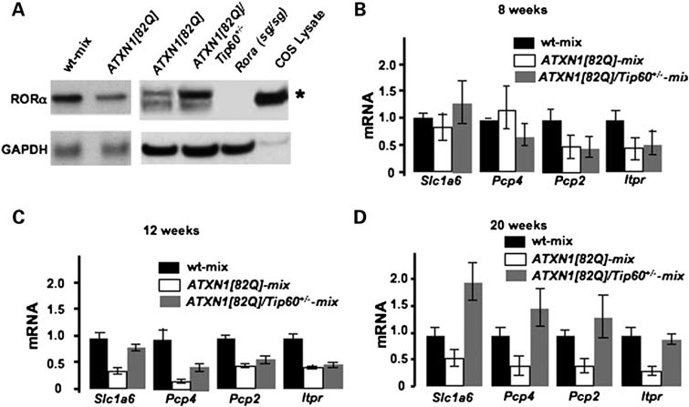
Partial Tip60 loss effect on Rora protein and gene expression

Slide 13
Conclusion
Tip60 interacts with ATXN1 by the AXH domain
Phosphorylation at position 776 strengthens interaction
Partial loss of Tip60 slowed neurodegeneration in Purkinje cells at mid-stage of disease
Partial Tip60 loss increased Rora protein expression and Rora mediated gene expression

Slide 14
Conclusion
No effect on early disease suggests ATXN1/Tip60 interaction has no effect on disease onset
ATXN1/Tip60 interaction contributes to SCA1 disease progression
Partial loss of Tip60 delays SCA1disease progression during mid-stage of disease

Slide 15
Future Research/Critique
Identify other pathways involved in SCA1
Block Tip60 from interacting at AXH domain
Toxicity of up-regulated Rora
Initiation of SCA1
What is the role of Tip60 and Rora in SCA1

